Slide 2
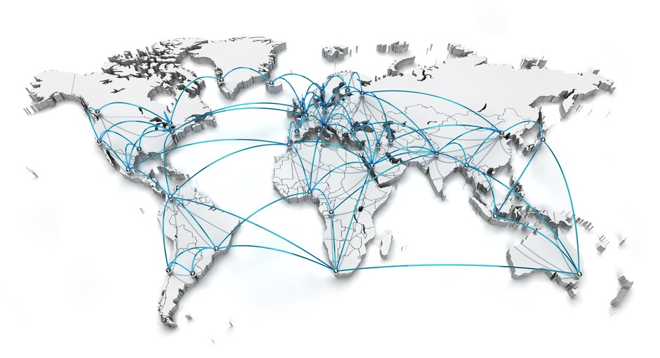
DJK GROUP
DAIICHI JITSUGYO CO., LTD. HEADQUATERS TOKYO, JAPAN
Established in 1948 in Japan | 72 years of experience
1069 employees worldwide
38 offices in 18 countries worldwide | global network
1.25 bil. EUR sales / year
Listed on the Tokyo Stock Exchange

Slide 3
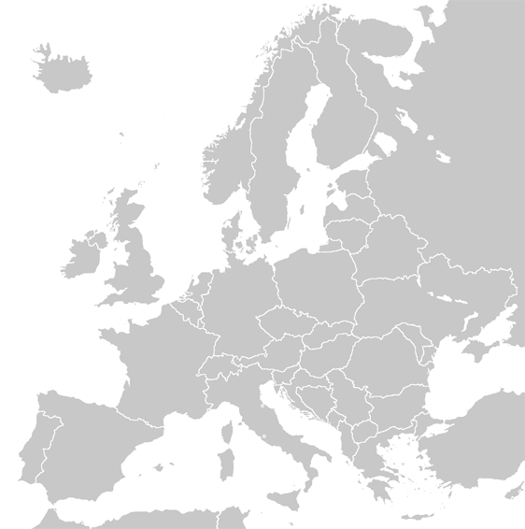
EUROPEAN ORGANIZATION
CZECH REPUBLIC
Prague Office
Sales & Service
HUNGARY
Budapest Office
Sales & Service
BULGARIA
Sofia Office
Sales & Service
European Head Office
GERMANY, Eschborn
(close to Frankfurt am Main)

Slide 4
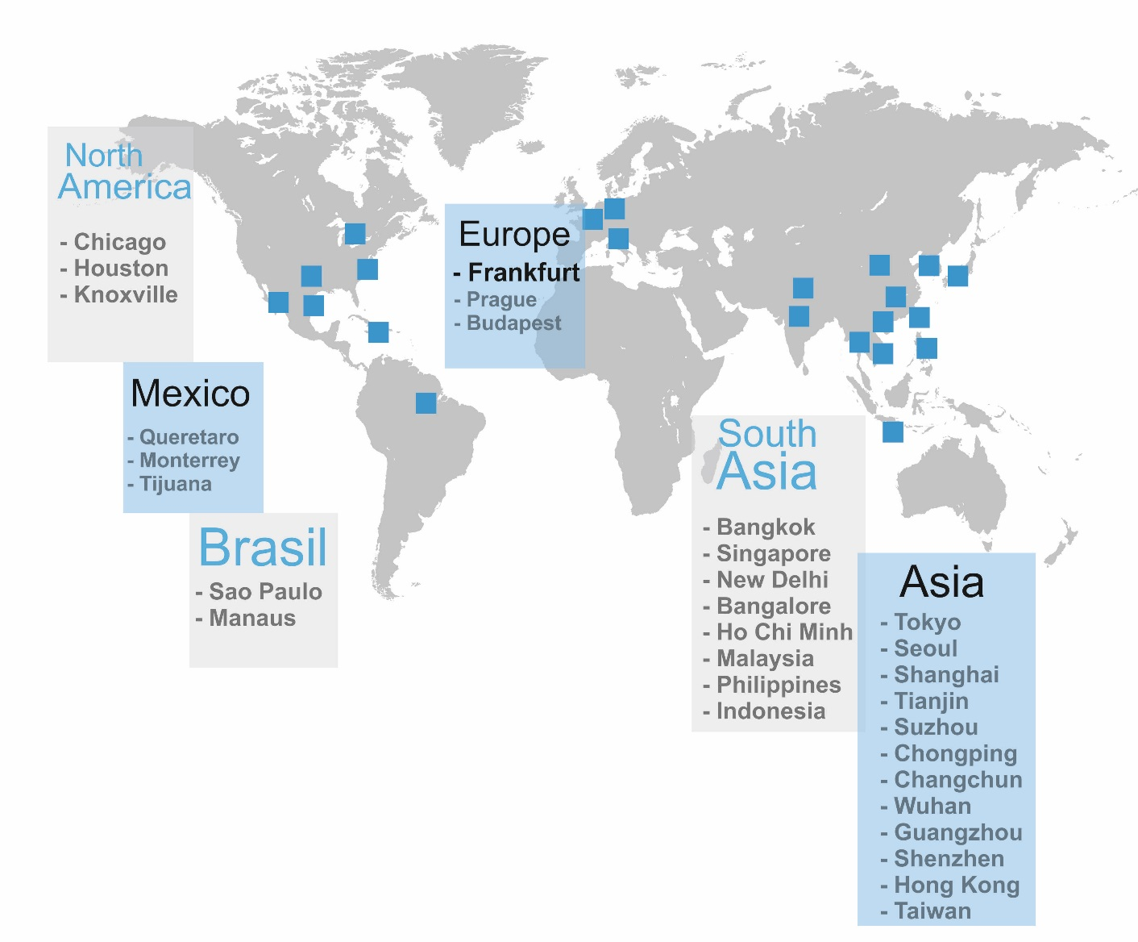
DJK GLOBAL NETWORK
- Sofia

Slide 5
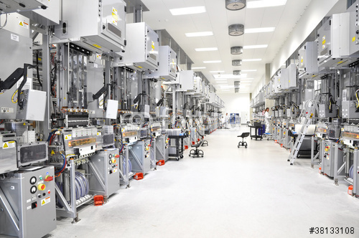
ABOUT US
PERFECT SOLUTIONS
DJK Europe GmbH is a subsidiary of the Japanese trading company Daiichi Jitsugyo Co. Ltd., and has its European Headquarter in Germany, close to Frankfurt am Main.
As an expanding sales and service company, our focus is to supply industrial facilities and equipment for the industry, coupled with an outstanding service and a global well-developed network.
Our staff have an in-depth knowledge. Experience, expertise and flexibility which distinguish us. We see our clients as partners and together we will find the most optimal solutions with a lot of know-how.
Starting from the sincere consultation, the client enjoys DJK Europe’s customer-first spirit throughout the whole procuration process and even further.

Slide 6
ABOUT US
DJK EUROPE - YOUR GLOBAL PARTNER – Professional supports for a simple purchase
Best equipment offer
Condition negotiation
Legal check
Document preparation
Delivery management
Technical service

Slide 7
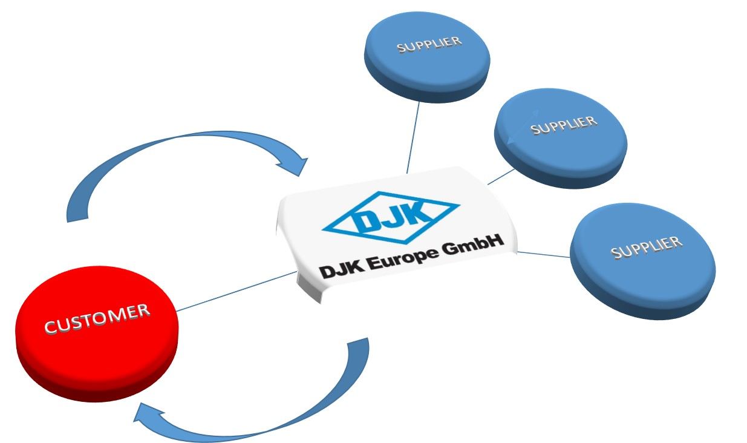
EXCELLENT SERVICE
PROFESSIONAL AND COMPREHENSIVE MANAGEMENT SERVICE
Are you planning to modernize your systems, to introduce new devices, to expand your production line or you ask yourself how to improve your productivity? Our customer-oriented service is the solution, because we offer everything from one source:
Individual consulting & product presentations in our in-house demo room
Applications
Installations
Training
Engineering service
Telephone support

Slide 8
EUROPEAN BUSINESS FIELDS
Electronics
Screen Printing
Pick & Place
Automotive
Metal Processing
Carbon Processing
Energy Engineering
Raw Material Production
Inspection
Cleaning
Additional Products
Environmental Test Chambers
System Integration
Electrode Production
Cell Assembly
Total Plant Engineering
Gateway Asia Europe
Business-Bridge to Asia
Business-Bridge to Europe

Slide 9
BUSINESS BRIDGE EUROPE - ASIA
In the modern business world, we have to adapt to a global market - benefit from our network !
From our intensive business contacts a unique Asian / European expertise grows up.
This is the reason, we become an important business partner for Japanese and Europeans companies which use our network to increase their business in the European / Japanese Market. Through the partnership with DJK Europe you have the opportunity to develop & operate your business and facilities efficiently and smoothly.
We act as a service and support center and we are the connecting bridge between the European and Asian market.

Slide 10
ELECTRONICS
Screen Printing
SPG Screen Printer
SP 70 Screen Printer
Pick & Place
AM 100 Modular Placement Machine
NPM-D – Production Modular
Inspection
SPI – Solder Paste Inspection
SPD- Screen Printer
NPM-W Production Modular
Cleaning
Metal Cleaning
Nozzle Cleaning
Additional Products
Solder Paste
Environmental Test Chambers
FRITSCH
AOI- Automatical Optical Inspection
X-Ray Inspection
Visual Inspection
Simple Inspection
Panasonic
Panasonic
Automatic Pick & Place Machine for high-mix-low-volume

Slide 11
AUTOMOTIVE
Metal Processing
Carbon Processing
Environmental Test Chambers
System Integration
Hot Chamber Die Casting
Cold Chamber Die Casting
Ultrasonic Cutter
Ultrasonic Inspection
Espec Chambers
Complete plants and partial solutions
X-Ray Inspection
Mold Maintenance
Painting Processing
Flocking Processing

Slide 12
ENERGY ENGINEERING
Raw Material Production
Electrode Production
Cell Assembly
Total Plant Engineering
Grinding
Classifying
Mixing
Spray Drying
Thermal Processing
Magnetic Separation
Dispersion
Paste Mixing
Coating & Drying
Solvent Recovery
Calendering
Inspection
Slitting
Final Drying
Winding & Sheet Separator
Stacking & Lamination
Electrode Welding
Electrolyte filling
X-Ray Inspection
Auto Storage & AGV Handling
Complete plants and partial solutions

Slide 13
GATEWAY ASIA - EUROPE
Aviation and Airport
Raw Material Production
Automotive
Total Solutions
Aircraft Tractor
Loader
Ground Power Supply
Mixing
Drying
Painting Processing
Plastics Processing
DJK Europe- Your Partner for Total Solutions
Electronics
Wirelaid Technology
Plant
Material Processing
Deicer
Passenger Stairs

Slide 14
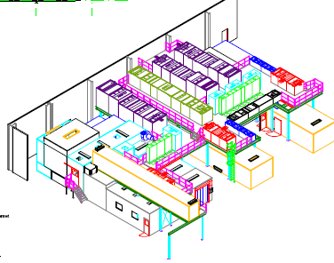
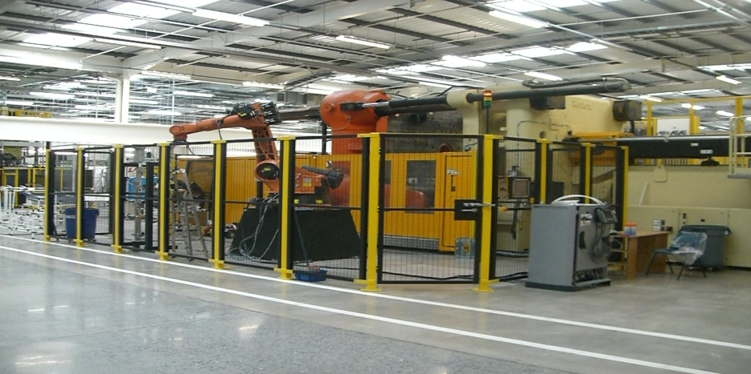
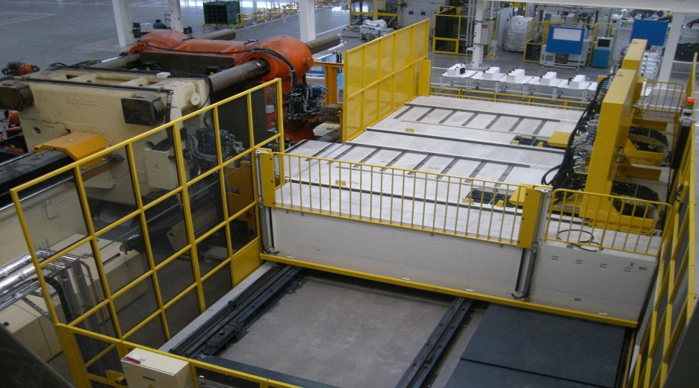
REFERENCES – TOTAL SOLUTION
DJK ORGANIZED ALL EQUIPMENT FOR TOTAL ENGINEERING PROJECTS
As an example | UK Project
• Injection Molding Machine (from 2500t to 50t)
• Material supply system
• Mold changer
• Complete coating system
• Urethane forming
• Trimming robot from Japan and Europe
• More than 20 suppliers

Slide 15
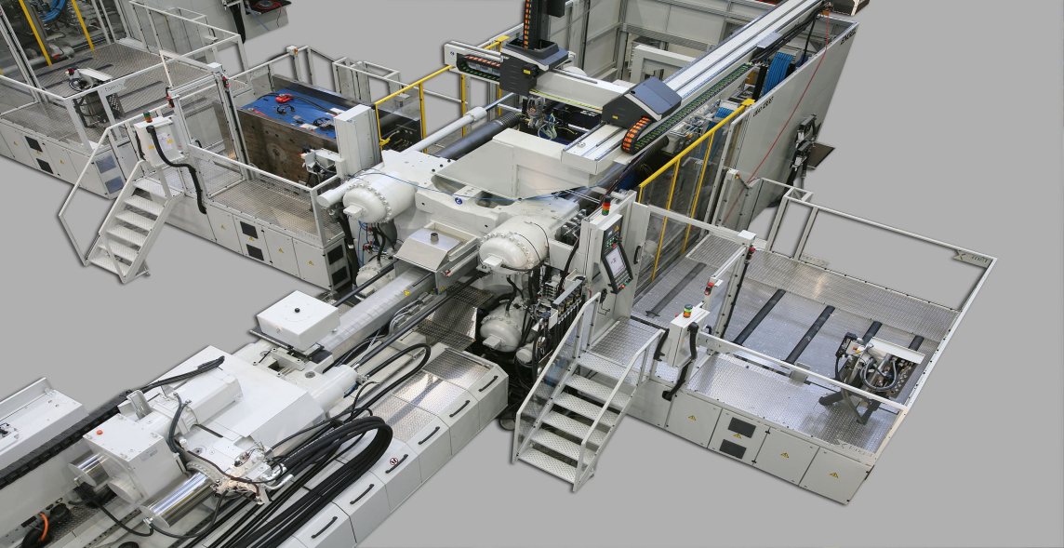
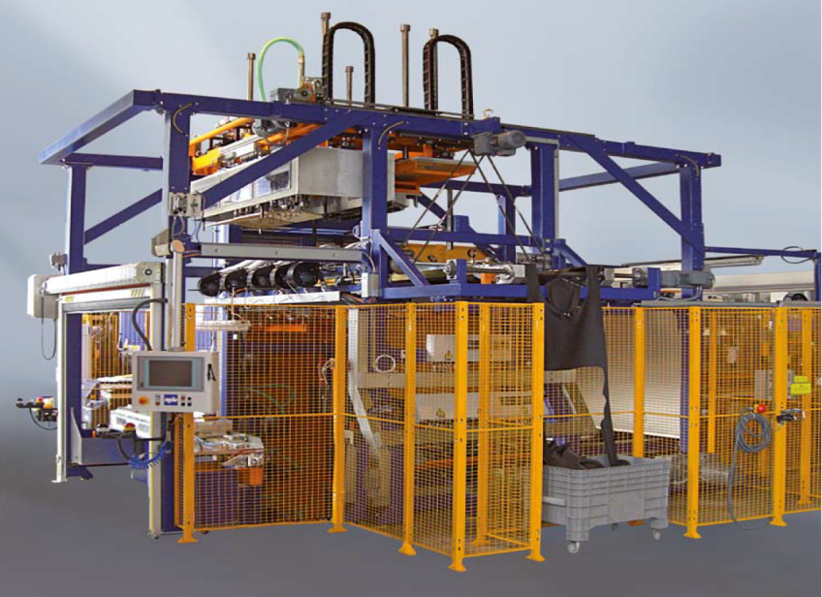
REFERENCES – TOTAL SOLUTION
WE MANAGE THE WHOLE PROJECT ON BEHALF OF THE CUSTOMER - SUPERVISE THE DELIVERY ON TIME AND DO THE INSTALLATION ON SITE
Manage all equipment (one package facility)
Technical discussion with Japan side
Combination with Japanese machines
Schedule control and transportation
Installation and supervisor arrangement
On site manager until acceptance

Slide 16
REFERENCE LIST OF EUROPEAN PARTNERS
b+m surface systems GmbH, Germany
ENGEL AUSTRIA GmbH, Austria
Vestergaard A/S, Denmark
Goldhofer AG, Germany
TREPEL Airport Equipment GmbH, Germany
Hitzinger GmbH, Austria
Lindor, Netherlands
Maag Flockmaschinen GmbH
JUMATECH GmbH, Germany
SMS Siemag AG, Germany
TAMPOPRINT AG, Germany
Electrolux, United Kingdom
Tantec A/S, Denmark
MINOX Group, Germany
Weatherford GmbH, Germany
Thermo Fisher GmbH, Germany
Lotus Engineering, United Kingdom

Slide 17
REFERENCES EUROPE
ADD BULGARIA

Slide 18
REFERENCES JAPAN

Slide 19
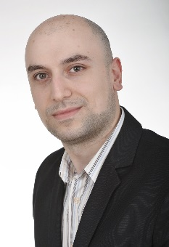
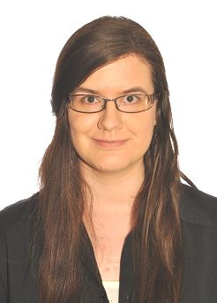
CONTACTS - EUROPE
DJK OFFICE CZECH REPUBLIC
Prague Office
Office Park Nove Butovice
Bucharova 1281/2
158 00 Praha 5
Ms. Lucie Chybova
lucie.chybova@djkeurope.com
Phone +420 233 320 090
DJK OFFICE BULGARIA
Mr. Deyan Gunev
Service Engineer
Phone +359 888 003 897
deyan.gunev@djkeurope.com
DJK OFFICE HUNGARY
Budapest Office
East West Business Center
Rákóczi út 1-3.
1088 Budapest
Ms. Eszter Varadi
eszter.varadi@djkeurope.com
Phone +36 1 235 0323

Slide 20
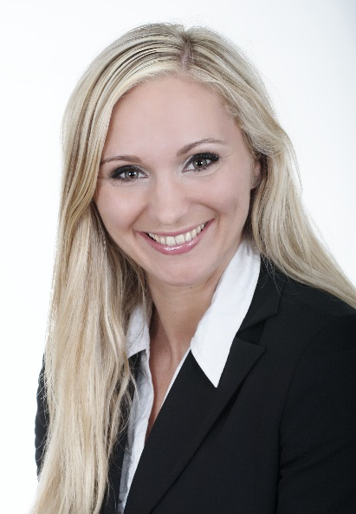
CONTACT
DJK EUROPE GMBH
Ms. Karin Henker
Sales & Head of Marketing
DJK Europe GmbH
Mergenthalerallee 79-81, D- 65760 Eschborn, Germany
Phone: + 49 6196 77614-15 / Fax: + 49 6196 77614-19
Email: karin.henker@djkeurope.com | www.djkeurope.com

